Slide 1
Multi-cohort study of the immune factors associated with M. Tuberculosis infection outcomes
Gaining a better understanding of the immune state of latent Mtb infection
Published: 2018 Chowdhury et. al.
Alex Norman, Kewei Ye, Jordan Smiley, Lexi Wittstadt, Selena Halabi, Lola, Loki, Rebel, Rogue, Anna, Ophelia, Bagel, Ruby, Milo, Clegg

Slide 2

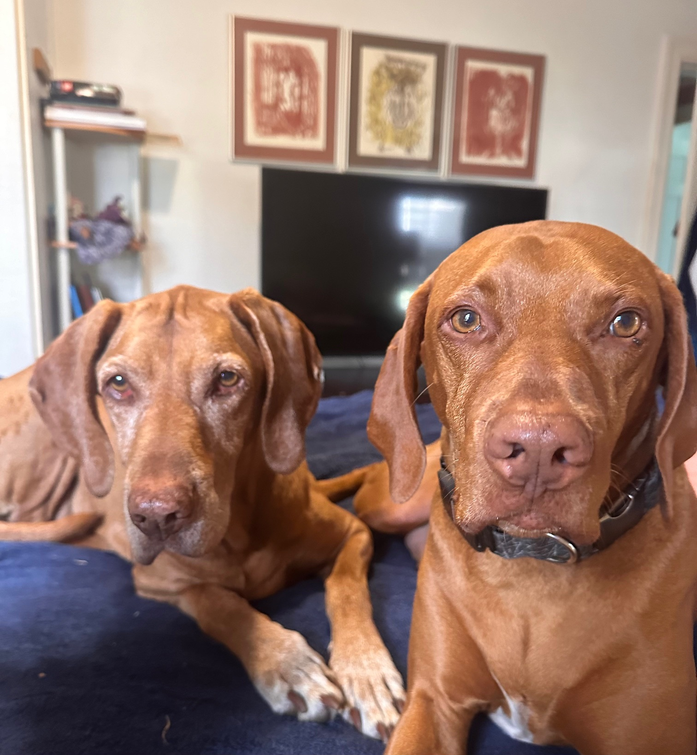

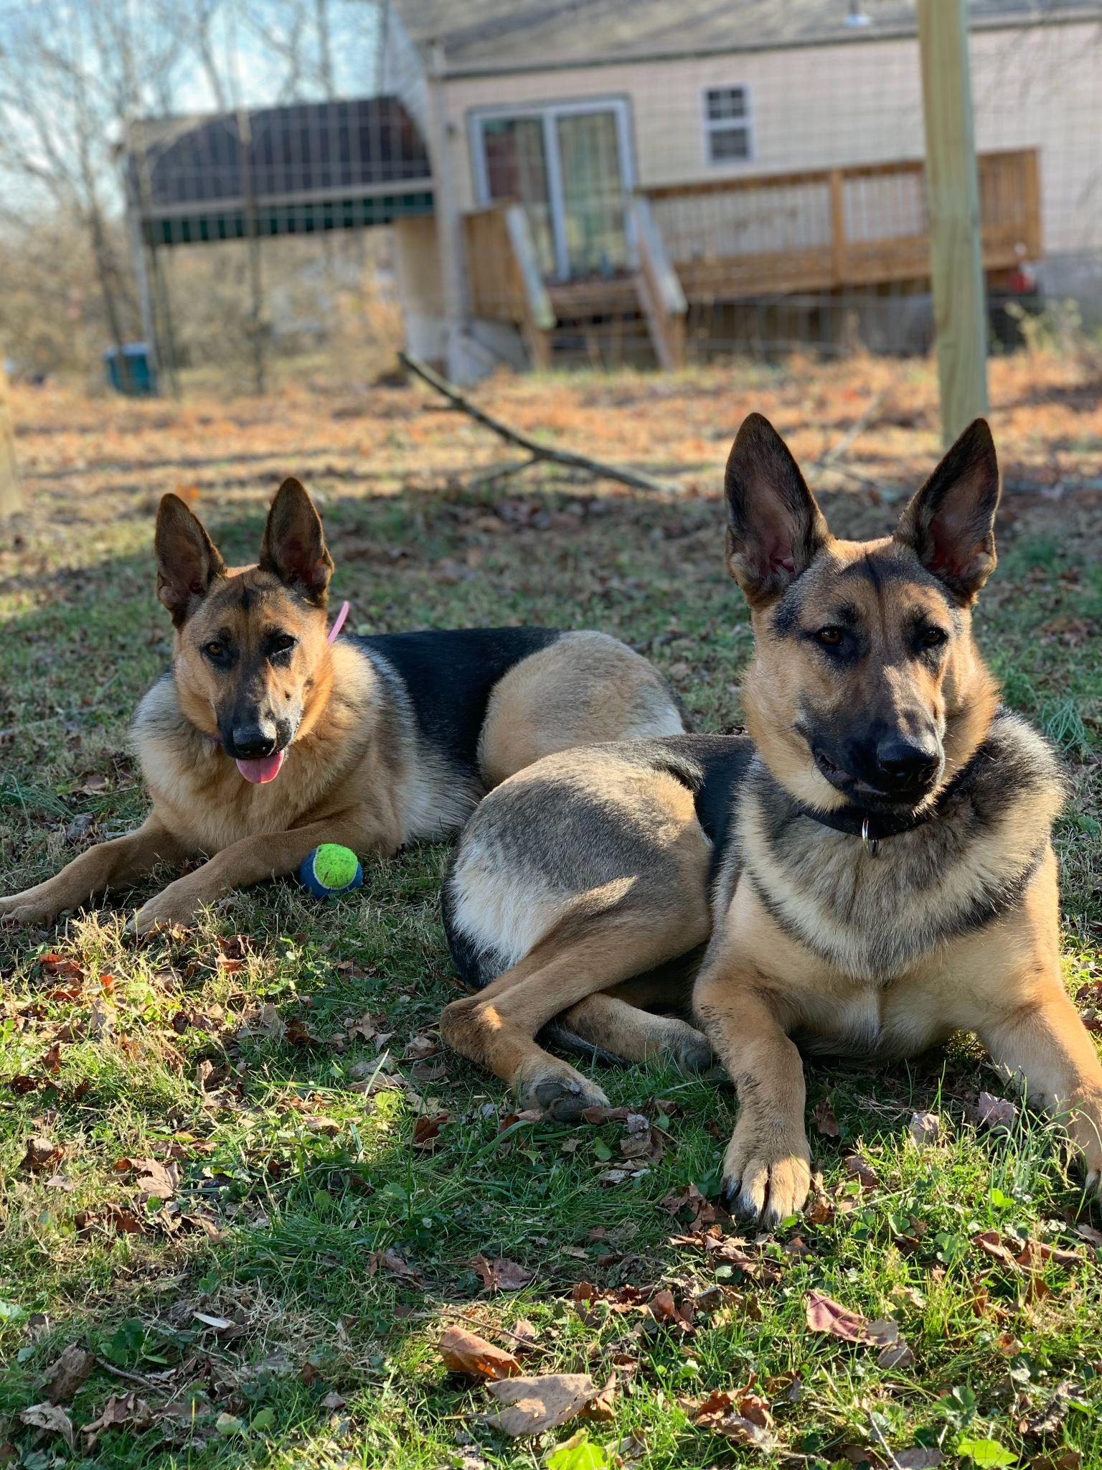




In the spirit of Polly Matzinger, our co-authors are…

Slide 3
Introduction

Slide 4




What is Tuberculosis?
Infection by Mycobacterium tuberculosis (Mtb)
Transmission through airborne bacteria
Multiple different states of infection:
Latent infection (LTBI) → ~¼ of the world’s population
Active infection → 1 in 10 individuals, symptoms present, can spread disease
Worldwide, but higher prevalence in certain areas (sub-Saharan Africa and Asia)
10 million people infected every year, 1.5 million deaths (WHO)
Symptoms:
Fever/chills
Chest pain
Cough
Fatigue
Coughing up blood/mucus
Weight loss
Notes:
Leading cause of death from infectious disease

Slide 5
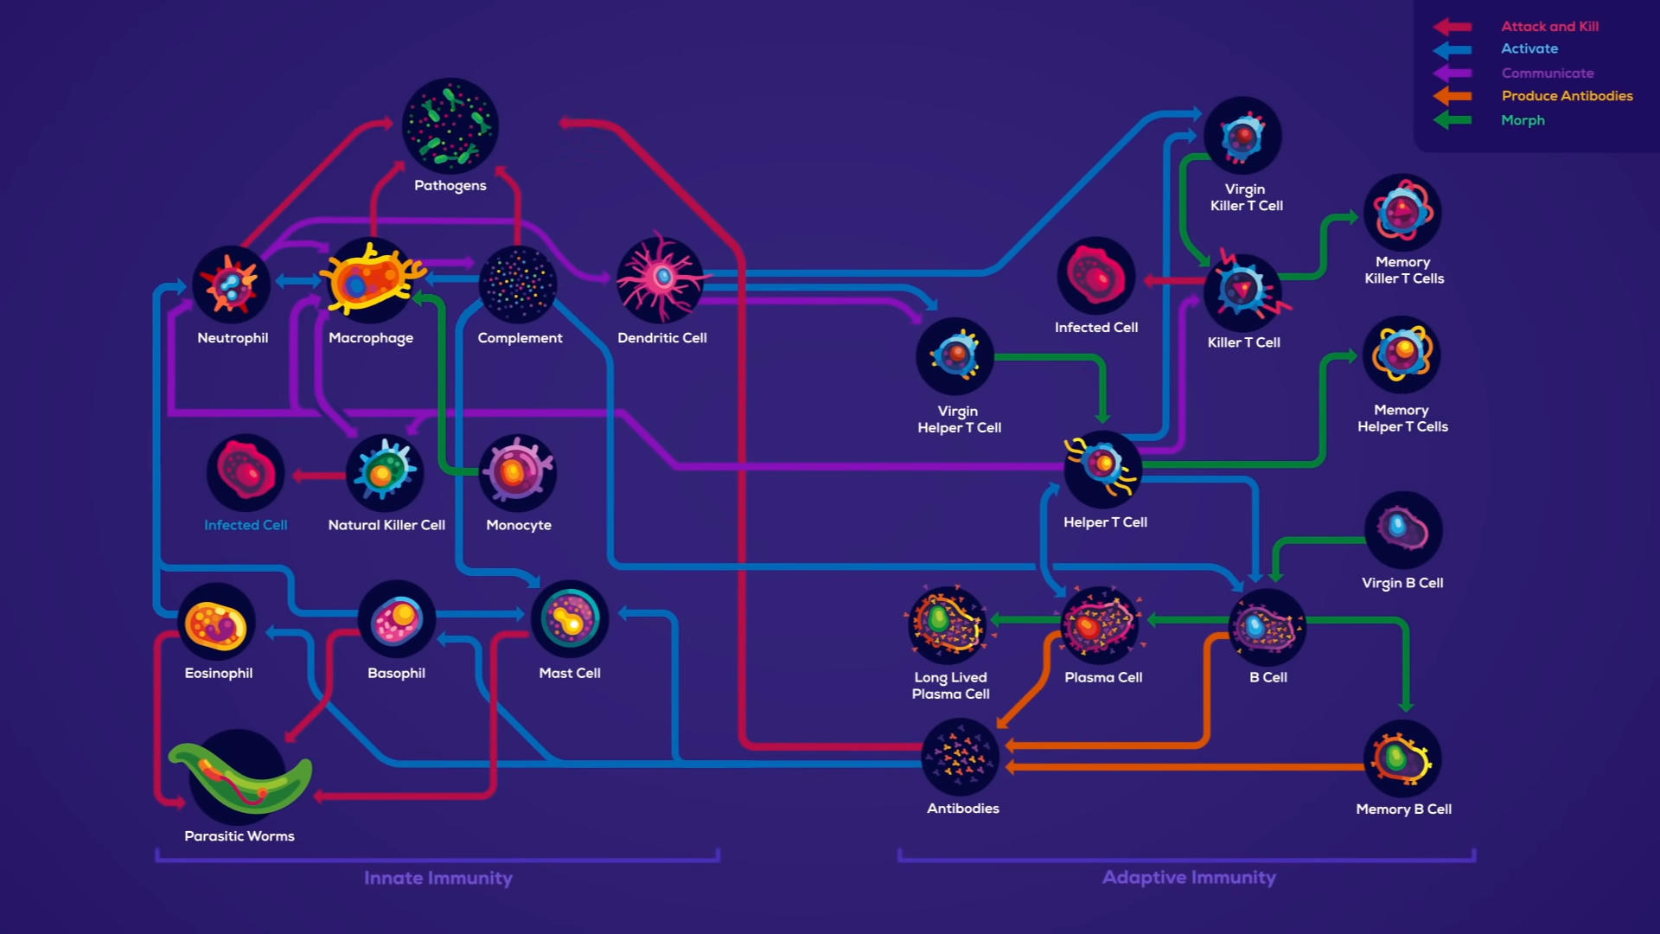
Important cell types to know
Kurzgesagt,
Immune by Philipp Dettmer
Notes:
Emphasis on the MULTIPLE COMPONENTS of the immune system and why the researchers wanted to look at several simultaneously

Slide 6
NK cells (natural killer cells)
Innate immune system
Functions:
Release cytokines (IFN-γ, TNF-⍺)
Release cytotoxic granules (perforin, granzymes)
Kurzgesagt,
Immune by Philipp Dettmer

Slide 7
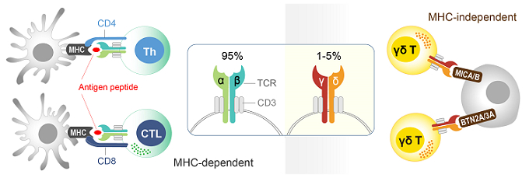
𝛂𝝱 T cells
Adaptive immune system
Functions:
CD4+ (helper T cells)
CD8+ (cytotoxic T cells)
Recognize antigen bound to MHC
Kurzgesagt,
Immune by Philipp Dettmer
Arigo Biolaboratories

Slide 8
𝝲𝝳 T cells
Innate immune system
Functions:
Commonly present in barrier tissues
MHC-independent receptor recognition
Release cytokines
Kurzgesagt,
Immune by Philipp Dettmer
Arigo Biolaboratories

Slide 9
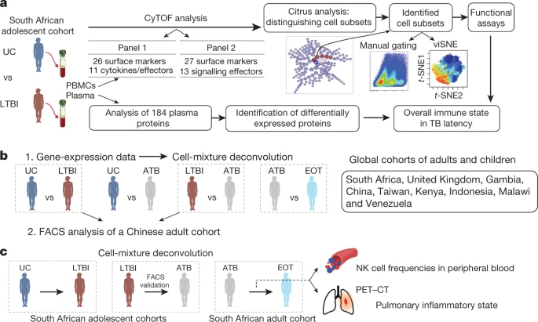
Experimental Design
Figure 2
Figure 3
Figure 4
Notes:
Purpose of the study - identify stage specific host responses to the infection to identify the immune factors that influence the infection outcomes.
Applicable to other diseases such as HIV
Multiple cohort study
Three experiment groups/methods, separated into three stages of the study:
Figure 1a: CyTOF of PBMC (peripheral blood mononuclear cells) in uninfected and latently infected adolescents in South Africa (endemic area, but well controlled/low rates of active TB)
Determine immune cell populations more prevalent in latent TB group than uninfected group
Figure 1b: Cell-mixture deconvolution of gene expression data of global cohorts, followed by FACS of Chinese adult cohort
Identify changes in immune cell subsets at different infection stages (unifected (UC), latent (LTBI), active (ATB), and end of treatment (EOT)
Figure 1c: Analysis of NK cell frequency following single individuals as they progress, South African cohorts
UC to LTBI - adolescent
LTBI to ATB - adolescent
ATB to EOT - adult
Methods: cell-mixture deconvolution, FACS, correlating NK frequency to PET-CT imaging

Slide 10
Methodology

Slide 11
Methodology: CyTOF
High-dimensional cytometry by time-of-flight (CyTOF): a proteomics technology that assesses the abundance of cell subsets, protein expression and activation of signalling pathways at the single-cell resolution
Used by authors to
Broadly characterize the immune state
Determine signalling capacity of immune cells in response to immune challenges
The authors studied peripheral blood mononuclear cells (PBMCs) from uninfected and latently infected adolescents from South Africa
Notes:
To broadly characterize this immune state, we used high-dimensional cytometry by time-of-flight (CyTOF), a proteomics technology that assesses the abundance of cell subsets, protein expression and activation of signalling pathways at the single-cell resolution
The ability of cells to respond to immune challenges is an important factor in maintaining host immune competence. To determine the signalling capacity of immune cells, we used CyTOF (Supplementary Table 2) to investigate their ability to transiently phosphorylate signalling effectors in response to PMA and ionomycin, IFNγ, TNF or combined anti-CD3 and anti-CD28 stimulation.

Slide 12
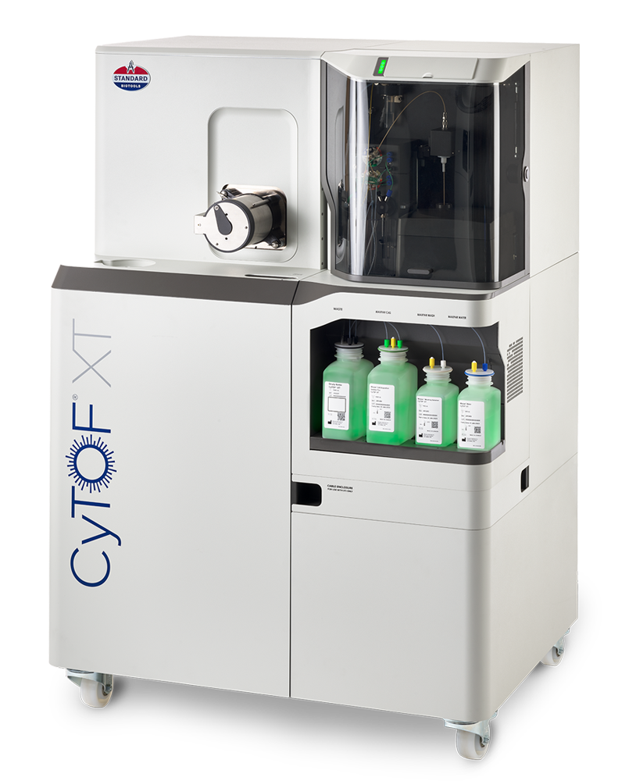

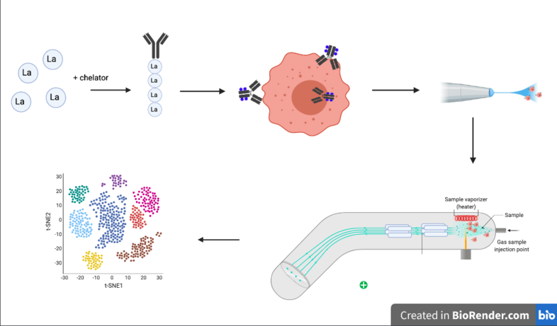
How does CyTOF work?
Stain with metal-tagged antibodies
PBMCs
https://www.standardbio.com/products/instruments/cytof-xt
Ilikecows13, CyTOF Workflow. Wikipedia. https://en.wikipedia.org/wiki/CyTOF
Notes:
CyTOF: an application of mass cytometry used to quantify labeled targets on the surface and interior of single cells. CyTOF allows the quantification of multiple cellular components simultaneously using an ICP-MS detector.
Time-of-flight mass spectrometry (TOFMS) is a method of mass spectrometry in which an ion's mass-to-charge ratio is determined by a time of flight measurement. Ions are accelerated by an electric field of known strength

Slide 13
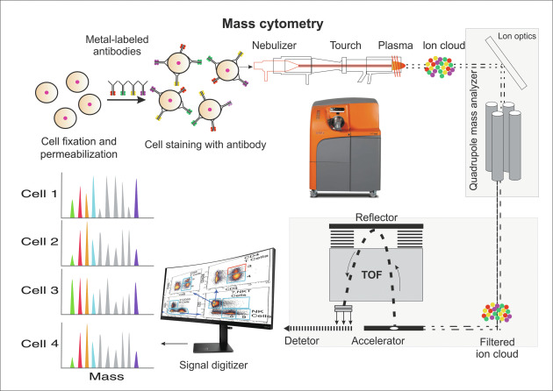
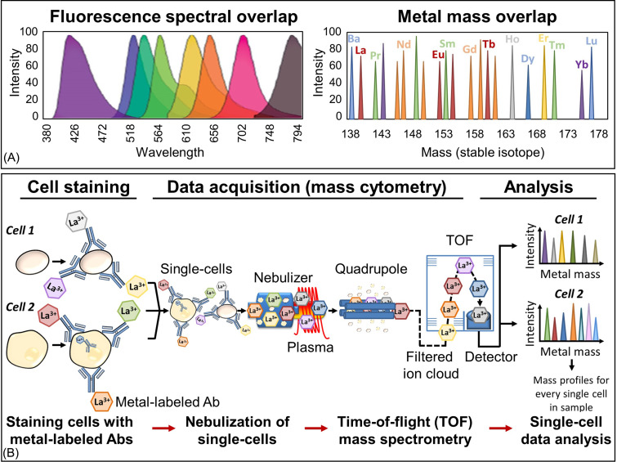
How does CyTOF work?
Flow Cytometry
Blair et al., Platelets (Fourth Edition), Ch. 35, 2019
CyTOF
Minakshi et al., Single-Cell Omics Volume 1 Ch. 14, 2019
Blair et al., Platelets (Fourth Edition), Ch. 35, 2019
Notes:
CyTOF: an application of mass cytometry used to quantify labeled targets on the surface and interior of single cells. CyTOF allows the quantification of multiple cellular components simultaneously using an ICP-MS detector.
Time-of-flight mass spectrometry (TOFMS) is a method of mass spectrometry in which an ion's mass-to-charge ratio is determined by a time of flight measurement. Ions are accelerated by an electric field of known strength

Slide 14
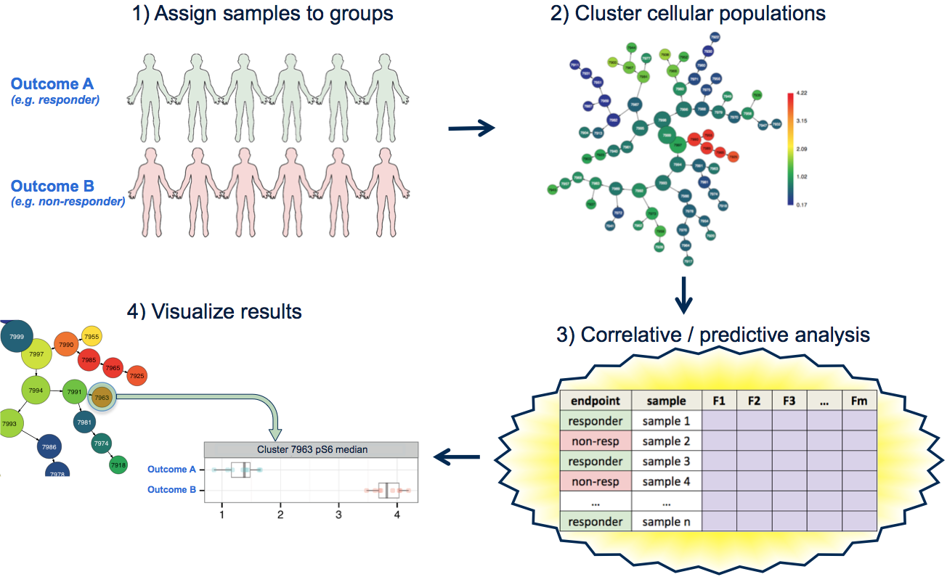
CITRUS (Cluster Identification, Characterization and Regression)
An algorithm that leverages unsupervised clustering and supervised predictive and correlative statistical association models to call out significant feature differences between experimental groups.
https://support.cytobank.org/hc/en-us/articles/226940667-Overview-of-CITRUS.
Notes:
A supervised machine learning algorithm designed to analyze single cell data, identify cell populations, and identify changes in the frequencies or functional marker expression patterns of those populations that are significantly associated with an outcome.
The algorithm is a black box that includes steps to cluster cell populations, characterize these populations, and identify the significant characteristics.
Hierarchical
Citrus let you compare groups of samples and not only tells you what parameters make the groups different but how significant those differences are. After identifying nodes of interest, you can export those nodes to a new Cytobank experiment.
It can be applied to Fantastic fo biomarker discovery
Clinical trials
Any reason you’d need to compare groups as opposed to individual samples
CITRUS (cluster identification, characterization, and regression) is an algorithm designed for the fully automated discovery of statistically significant stratifying biological signatures within single cell datasets containing numerous samples across multiple known endpoints (e.g., responders versus non-responders). CITRUS proceeds through multiple steps, the first of which is unsupervised hierarchical clustering to identify clusters of cellular populations within the overall dataset. After clustered populations are identified, biologically relevant features of these clustered populations are calculated per sample. Features may be either relative abundance of cells in each population compared to the whole sample, or median expression level of functional markers measured across the cells for each population. CITRUS then uses a regularized supervised learning algorithm to determine the populations and features that best predict which endpoint group any given sample belongs to, or uses correlative methods for a correlative measure of the same. The results of a CITRUS run are clusters (populations) that differentiate the observed endpoint of the samples, and the features (relative population abundance or median expression of a functional marker) of the clusters that are responsible.

Slide 15
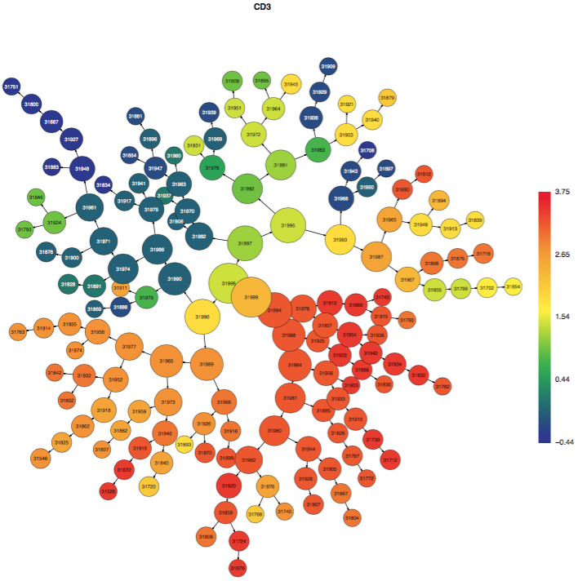
Citrus Example
Cluster Characterization
Median & Abundance
https://support.cytobank.org/hc/en-us/articles/227268328-Analysis-and-Intepretation-of-CITRUS-Results
Notes:
How does citrus work
Branch clustering of cells based on similar marker expression patterns
Node
Color
All the events in this node are also in this node.
The node at each end of branch is the most phenotipically pure population
Citrus begins by identifying clusters of phenotypically similar cells in all samples in a hierarchical, unsupervised manner
Citrus uses regularized super ised learning algorithms to identify stratifying clusters and cell responses features that are the best predictors of a known experimental endpoint of interest
Medians and abundances are two functional biomarkers.
Median is which markers have statistically significant differences in expression between groups. )Predicftive/regreesision. Groups are non-responders and responders to cancer therapy. Determine which biomarkers predict response.
Abundances are which clusters have statistically significance differences in abundance between groups. Examples(correlative) Groups are cancer patienst with stable disease and patients with progressive disease. Determine whether there are variations in the abundance of their Treg populations.

Slide 16
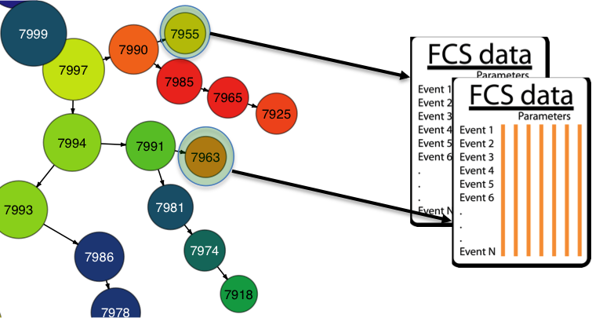
Steps of Citrus Analysis
FCS files of normalized, ‘live cell/no beads’ samples were randomly sampled for n single-cell events.
Collected single-cell events were pooled and iteratively hierarchically clustered based on similarity of expression of subsets of the measured channels.
The pooled dataset was split back into its constitutive samples, and the relative abundance of cells in each cluster was computed, as well as the median expression of each functional marker in each cluster.
Used the SAM algorithm in Citrus, which assesses FDR by permutations.
https://support.cytobank.org/hc/en-us/articles/228224108-Exporting-Clusters-from-a-CITRUS-Analysis-as-New-FCS-Files
Notes:
Cytobank is a web-based analysis archive and collaboration tool designed to run cytometry data.
Look at large group-wise comparison
Citrus analysis consists of the following steps. First, FCS files of normalized, ‘live cell/no beads’ samples were randomly sampled for n single-cell events. Second, collected single-cell events were pooled and iteratively hierarchically clustered based on similarity of expression of subsets of the measured channels. This procedure yielded overlapping clusters with the largest cluster encompassing all of the sampled events. Third, the pooled dataset was split back into its constitutive samples, and the relative abundance of cells in each cluster was computed, as well as the median expression of each functional marker in each cluster. Only clusters for which the abundance in one or more of the measured samples was greater than some lower-bound P values were considered for downstream differential analysis. Fourth, to determine differences in cell subset abundances or functional marker medians expression, we used the SAM algorithm in Citrus, which assesses FDR by permutations. For each set of analysis, we set n to 20,000 and the clustering threshold to 1% of total cells and performed the analysis iteratively such that 20,000 events from the entire dataset were chosen randomly for the multiple rounds of analysis. We also analysed the entire dataset in R. These analyses yielded qualitatively similar results. Analyses of abundance

Slide 17
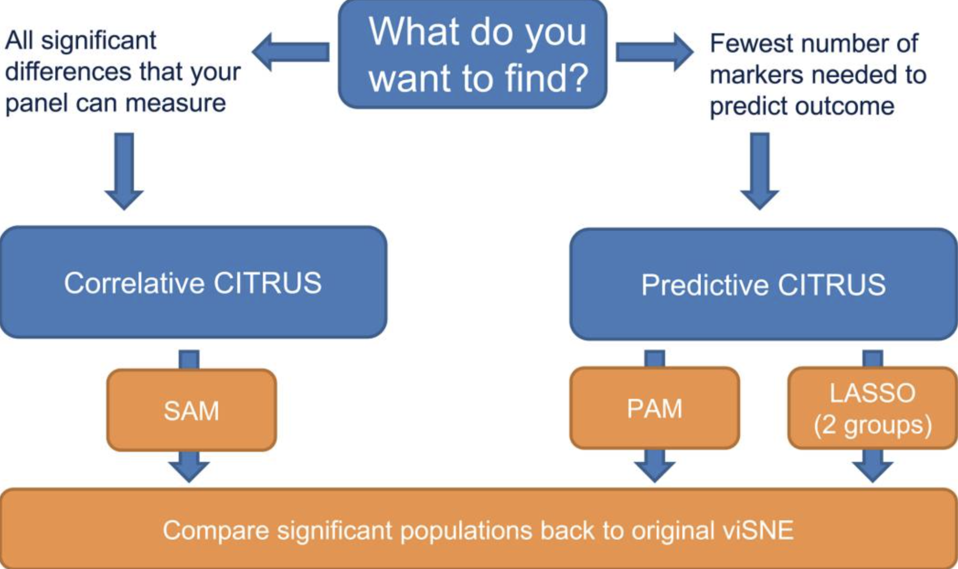
SAM algorithm - Significant Analysis of Microarrays
Used for large-scale gene or protein expression data like those collected with microarrays.
Applied a t-test at the individual gene or protein level
determines whether the expression pattern for that gene or protein is significant.
Polikowsky et al. Mass Cytometry: Methods and Protocols (2019): 309-332.
Notes:
It addresses the issue of analyzing large-scale data in which a microarray experiment of 10,000 proteins would identify 100 proteins by chance using a p-value cut-off of 0.01.

Slide 18
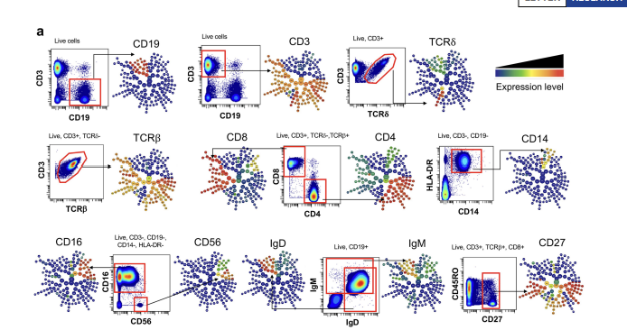
Citrus - in this paper
Used for comparison between cell subset abundance and functional marker expression in PBMCs from uninfected controls and subjects with LTBI.
Notes:
PBMCs from 14 latently infected and 14 uninfected participants of a South African adolescent cohort were characterized using CyTOF with antibody panel 1 (Supplementary Table 2), followed by Citrus analysis and clustering. This unsupervised hierarchical clustering analysis produced a branching structure (dendrogram) that allowed the grouping of total live cells into known immune cell compartments (contoured). Cell clusters are represented as nodes (circles) in this Citrus-derived circular dendrogram, which delineates lineage relationships that were identified from the data. Cluster granularity (that is, cell subset specificity) increases from the centre of the diagram to the periphery.
a, Annotation of cluster hierarchy plots based on surface marker expression. The expression intensity of each marker used for cell population characterization is overlaid per cluster on the Citrus circular dendrogram and is indicated, independently for each marker, by the coloured gradient for which the range corresponds to the arcsinhtransformed expression of the median marker expression measured across all Citrus clusters. For each marker, we also provide a dot plot graph demonstrating the marker labelling in the manually gated indicated population.
Manual gating was performed on the Cytobank website on normalized, debarcoded data files. A hierarchical gating strategy was used to identify live, single cells of the main PBMC populations (Extended Data Fig. 1a) and their subsets based on the expression of surface, cytokine or signalling molecules.

Slide 19
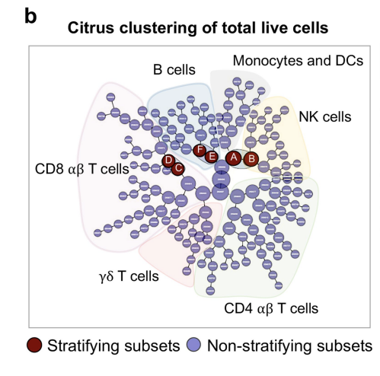
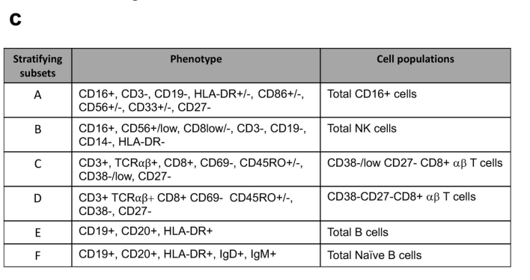
Citrus - in this paper
Notes:
. b, Citrus plots showing, based on cell-surface protein expression, clusters (in red, designated A–F) that exhibit significantly different abundances (SAM analysis with FDR < 1%) between the uninfected and latently infected individuals. Individual cell clusters are mapped to well-established, gross-cell types: B cells (CD19+), CD8+ αβ T cells (CD3+TCRβ+CD8+), CD4+ αβ T cells (CD3+TCRβ+CD4+), γδ T cells (CD3+TCRδ+), monocytes (CD3−CD19−CD33+CD14+HLA-DR+), NK cells (CD3−CD19−CD14−HLA-DR−CD16+CD56bright/dim), identifiable by annotated shaded background groupings. c, The phenotype and the composition of cells in each of the stratifying cell subsets (A–F), identified by Citrus analysis

Slide 20
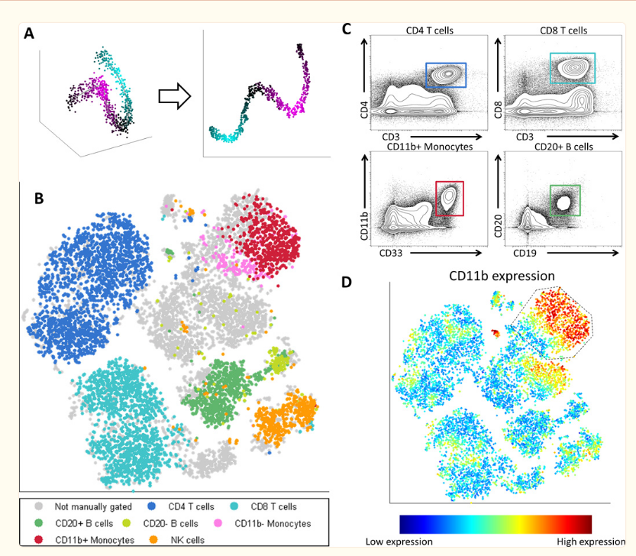
viSNE (Visualization of High-Dimensional Single-Cell Data)
Reduces high parameter biological data down to two dimensions
Single cell resolution is still maintained
Allows researchers to identify phenotypically distinguishable cell subsets and gate single cell events
Visualization can be limited
From Amir el-AD et al. Nat Biotechnol 2013

Slide 21
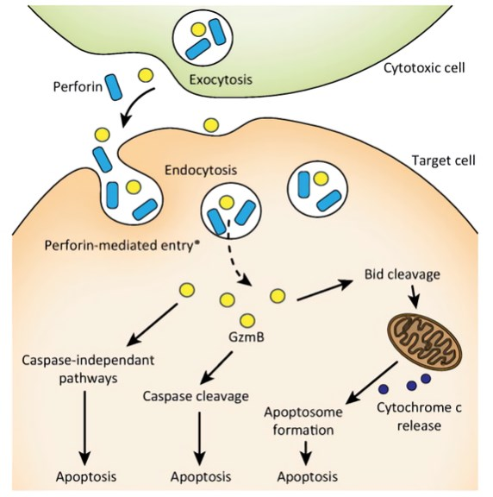
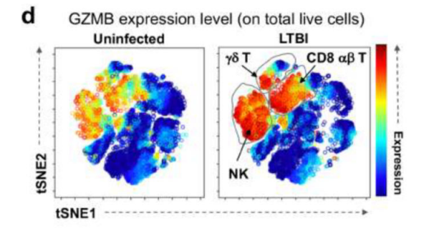
viSNE Analysis Findings
Granzyme B (GZMB) expression level in 14 uninfected patients and 14 LTBI patients analyzed
GZMB released by lymphocytes and NK cells to kill infected and tumor cells
Significantly more expression found in all cell subsets for LTBI patients over uninfected patients
Hiebert et al., Trends in Molecular Medicine, 2012

Slide 22
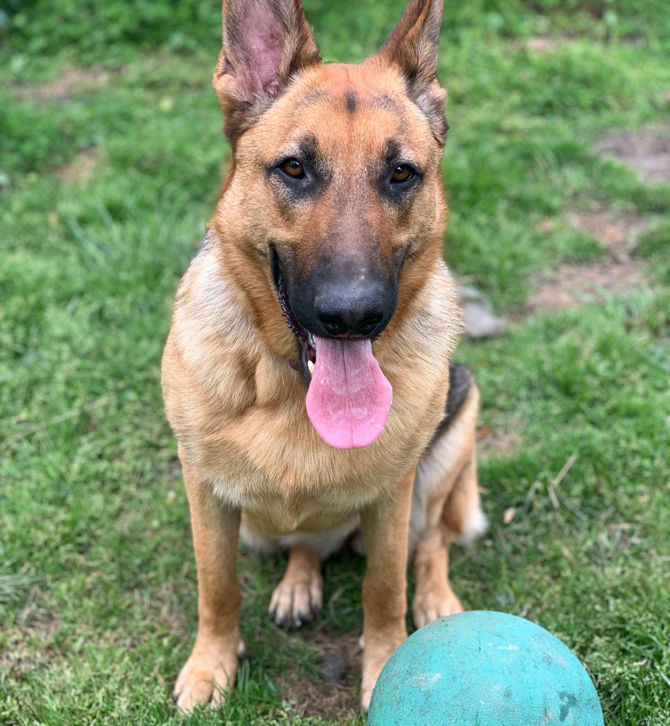
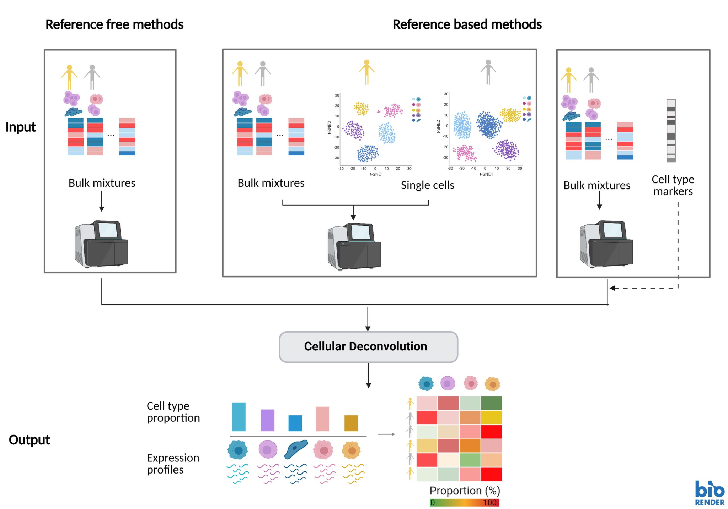
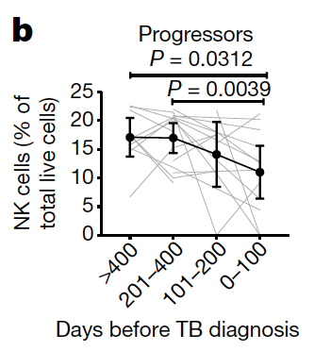
Cell Mixture Deconvolution
Computational technique
Measures proportions of different cell types in a mixed sample
Bulk gene expression data to identify individual cell types
Percentage of the total live cells
Fig. 4b Statistical Significance of NK cell levels
https://en.wikipedia.org/wiki/Cellular_deconvolution
Notes:
Diagram from: https://en.wikipedia.org/wiki/Cellular_deconvolution
Percentage of NK cells decreased during the progression of disease

Slide 23
Results

Slide 24
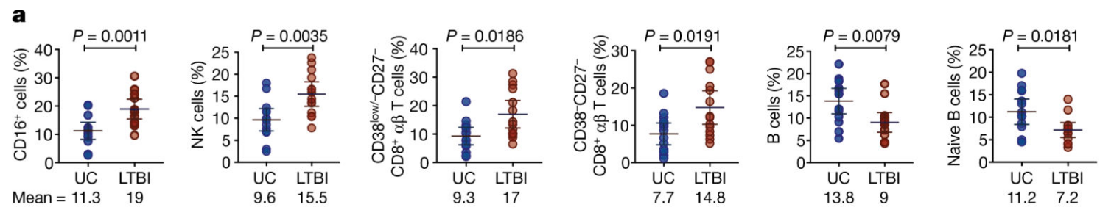
Analysis of cell subsets defined by surface protein expression
Significant differences in the percentage of immune effector cell subsets between samples from uninfected controls and individuals with LTBI were identified.
Notes:
An initial analysis of 14 uninfected controls and 14 individuals with LTBI was conducted to identify cell subsets defined by cell-surface protein expression. The authors identify 4 cell subsets with a significantly higher percentage (of total live cells) in individuals with LTBI than uninfected controls (false discovery rate (FDR) of <1%). These four subsets comprised total cells expressing CD16 (which is a surface receptor present on NKs and other cells), natural killer (NK) cells and two closely related populations of CD27−CD8+ αβ T cells that differed in their CD38 expression.
By contrast, two other cell subsets, total B cells and naive B cells, were significantly less abundant in individuals with LTBI
Reductions in the levels of peripheral B cells could be due to preferential sequestration of these cells at the site of infection (lungs and associated lymph nodes) and/or altered output of B cells from the bone marrow; inflammation can lead to enhanced myelopoiesis with diminished B cell output.
Because latently infected individuals show no significant change in peripheral monocyte or lymphocyte counts compared to uninfected controls, changes in the percentage of a given cell type most likely reflect corresponding alterations in its abundance.
CD38 also functions in cell adhesion, signal transduction and calcium signaling.
CD27, or cluster of differentiation 27, is a co-stimulatory receptor that plays a key role in the activation of T cells, NK cells, and B cells

Slide 25
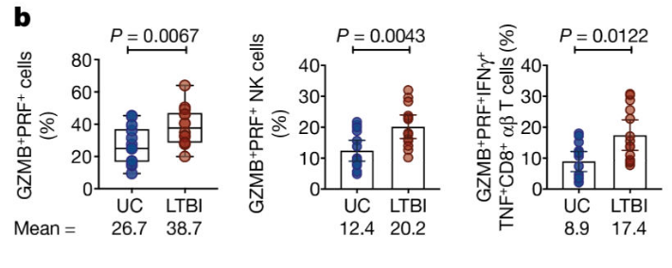
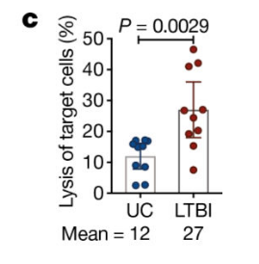
Enhanced cytotoxic potential
Granzyme B (GZMB)-and perforin (PRF)-expressing cells were significantly higher in individuals with LTBI.
NK cells from individuals with LTBI showed significantly higher target cell lysis than those from uninfected controls
Notes:
Granzyme B is a serine protease that is released by cytotoxic T lymphocytes (CTLs) and natural killer (NK) cells to kill infected or cancerous cells (as we saw in vISNE)
Perforin: a protein, released by killer cells of the immune system, which destroys targeted cells by creating lesions like pores in their membranes.
2b - Granzyme B (GZMB) and perforin (PRF) expressing cells were significantly higher in individuals with LTBI. These mostly consisted of NK cells and GZMB+PRF+IFNγ+TNF+ polyfunctional cells, which largely comprised CD27−CD8+ αβ T cells, but also included NK cells and γδ T cells
Points to an enhanced cytotoxic potential on a per-cell basis
Panel c aligns with this: NK cells from individuals with LTBI showed significantly higher target cell lysis than those from uninfected controls
enhanced cytotoxic responses that are mostly mediated by CD16 and NK cells appeared to be key factors associated with maintaining latency, which we propose represents successful immune control of Mtbinfection

Slide 26
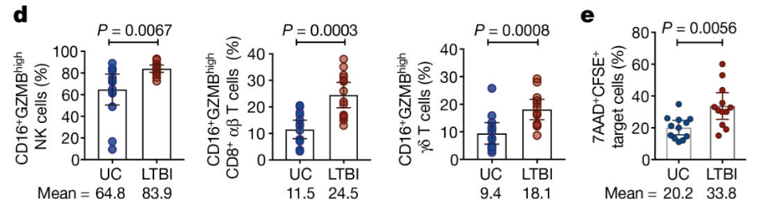
Pronounced ADCC
2d. Higher percentages of CD16⁺GZMB^{high} cells within the compartments of the NK cells, CD8+ αβ T cells and γδ T cells in PBMCs from individuals with LTB
2e. BMCs from individuals with LTBI also mounted significantly higher antibody-dependent cell-mediated cytotoxicity (ADCC) responses than those from uninfected controls
Notes:
2d - Additionally, there were higher percentages of CD16+, GZMB-high cells within the compartments of the NK cells, CD8+ αβ T cells and γδ T cells in PBMCs from individuals with LTBI.
2e - PBMCs from individuals with LTBI also mounted significantly higher antibody-dependent cell-mediated cytotoxicity (ADCC) responses than those from uninfected controls
ADCC allows antibodies, in addition to T cells, to contribute to the antigen-specific cytotoxic response.
It’s been reported that antibodies from individuals with LTBI, compared to those from patients with active TB, have unique Fc functional profiles that promote selective binding to CD16 and effectively drive intracellular Mtb killing

Slide 27
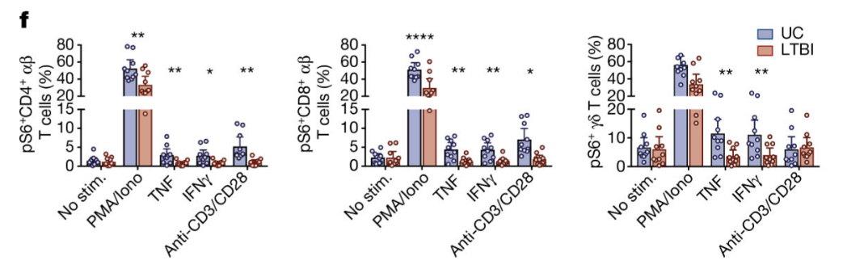
Signaling Capacity of Immune Cells
Fig. 2f. In individuals with LTBI, all T cell subsets exhibited diminished responsiveness through the S6 signalling pathway, irrespective of the stimulation condition, with the exception of γδ T cells after stimulation with both anti-CD3 and anti-CD28, as compared to cells from uninfected controls
Notes:
The ability of cells to respond to immune challenges is an important factor in maintaining host immune competence.
To determine the signalling capacity of immune cells, we used CyTOF to investigate their ability to transiently phosphorylate signalling effectors in response to PMA and ionomycin, IFNγ, TNF or combined anti-CD3 and anti-CD28 stimulation. We found that in individuals with LTBI, all T cell subsets exhibited diminished responsiveness through the S6 signalling pathway, irrespective of the stimulation condition, with the exception of γδ T cells after stimulation with both anti-CD3 and anti-CD28, as compared to cells from uninfected controls (Fig. 2f). S6, a ribosomal component, ribosome biogenesis, cell growth and proliferation.
Significantly diminished responsiveness through the S6 pathway, which may foretell the eventual drop in peripheral T cell levels observed in patients with active TB

Slide 28
Discussion

Slide 29

CyTOF
Advantages
Applications to other illnesses (example HIV)
Shows a “big picture” of disease progression
Simultaneous analysis of cell processes
Observe concurrent cell behavior (signalling, proliferation, etc) under given conditions
Greater number of targets than possible with traditional flow cytometry (which has spectral overlap)
Spectral flow cytometry can address this!
Disadvantages
Cell loss, requires high number of samples, no cell recovery
Challenging to measure small molecule metabolites
Reduced sensitivity of metal masses signal with respect to fluorescence signals, making the analysis of low signals difficult
Slower than flow cytometry
Complexity in data analysis

Slide 30

Summary of the Paper
CyTOF and cell deconvolution
Changes in the levels of NK cells and inflammatory state
predict progression on Mtb and response to treatment
Better understanding of the pathophysiology of latent TB
Identify multiple factors that influence patient outcomes
Very useful for patients with autoimmune diseases (such as HIV/AIDS)
TB is most fatal in this population
NK cells show progressive impairment
CyTOF + CITRUS + viSNE
Machine learning combination to understanding the complexity of biological systems
Kurzgesagt,
Immune by Philipp Dettmer

Slide 31
References
Amir el-AD, Davis KL, Tadmor MD, Simonds EF, Levine JH, Bendall SC, Shenfeld DK, Krishnaswamy S, Nolan GP, Pe'er D. viSNE enables visualization of high dimensional single-cell data and reveals phenotypic heterogeneity of leukemia. Nat Biotechnol. 2013 Jun;31(6):545-52. doi: 10.1038/nbt.2594. Epub 2013 May 19. PMID: 23685480; PMCID: PMC4076922.
Matthew H. Spitzer, Garry P. Nolan,Mass Cytometry: Single Cells, Many Features,
Cell,Volume 165, Issue 4,2016,Pages 780-791,ISSN 0092-8674, https://doi.org/10.1016/j.cell.2016.04.019. (https://www.sciencedirect.com/science/article/pii/S009286741630410X)
Cytobank. "Overview of CITRUS." Cytobank Support. https://support.cytobank.org/hc/en-us/articles/226940667-Overview-of-CITRUS.
Polikowsky, Hannah G., and Katherine A. Drake. "Supervised machine learning with CITRUS for single cell biomarker discovery." Mass Cytometry: Methods and Protocols (2019): 309-332.
Bruggner, Robert V., Bernd Bodenmiller, David L. Dill, Robert J. Tibshirani, and Garry P. Nolan. "Automated identification of stratifying signatures in cellular subpopulations." Proceedings of the National Academy of Sciences 111, no. 26 (2014): E2770-E2777.
RayBiotech. "SAM: Statistical Analysis of Microarrays." RayBiotech Learning Center. https://www.raybiotech.com/learning-center/sam/#:~:text=SAM%20is%20a%20method%20used,value%20cut%2Doff%20of%200.01.

Slide 32
Thanks!
Do you have any questions?

